Slide 1
FILE HANDLING
CDAC- Mumbai

Slide 2
STANDARD I/O OR SYSTEM LEVEL I/O
There are two ways of file processing.
Standard i/o(also called stream i/o or high level i/o)
System level i/o(also called low level i/o)

Slide 3
FILE INFORMATION TABLE
A program requires several pieces of information about a file, including the name the OS uses for it, the position of the current character, etc.
C uses a structure called FILE (defined in stdio.h) to store the attributes of a file.

Slide 4
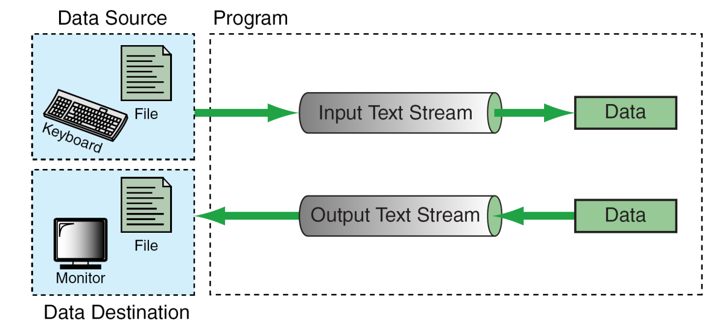
STREAMS
In C, we input/output data using streams. We can associate a stream with a device (i.e. the terminal) or with a file.
C supports two types of files
  Text Stream Files
  Binary Stream Files

Slide 5
TEXT STREAMS & BINARY STREAMS
Text streams consist of sequential characters divided into lines. Each line terminates with the newline character (\n).
Binary streams consist of data values such as integers, floats or complex data types, “using their memory representation.

Slide 6
Text File:
Data is stored in human readable form.
Each line of data ends with a newline character.
There is a special character called end-of-file(EOF) (1A hex)marker at the end of the file.
Int x =255; char ch = ‘A’
2 5 5 A
00110010 | 00110101 | 00110101 | 01000001

Slide 7
Binary File:
Data is stored in the same format as it is stored in memory.
There are no lines or newline character.
There is an end-of-file marker at the end of the file, which is usually system dependent.
int x = 255; char ch =‘A’
←-----------255--------------→ A
00000000 | 111111111 | 01000001

Slide 8
STEPS IN PROCESSING A FILE
Create the stream via a pointer variable using the FILE structure:
FILE* spData;
Open the file, associating the stream name with the file name.
Read or write the data.
Close the file.

Slide 9
SYSTEM-CREATED STREAMS
C automatically creates three streams that it opens and closes automatically for us in order to communicate with the terminal:
  stdin
  stdout
  stderr
We cannot re-declare these streams in our programs.

Slide 10
STANDARD FILE I/O FUNCTIONS IN C
Character I/O functions
fgetc(), fputc()
String I/O functions
fgets(), fputs()
File I/O functions
integer I/O functions
getw(), putw()
Formatted I/O functions
fscanf(), fprintf()
Record I/O functions
fread(), fwrite()

Slide 11
FILE OPEN
The file open function (fopen) serves two purposes:
  It makes the connection between the physical file and the stream.
  It creates “a program file structure to store the information” C needs to process the file.
Syntax:
FILE * fopen(const char *filename, const char *mode);
Return value:
on success, it returns a pointer to the opened stream
On Error, it returns NULL.

Slide 12
MORE ON FOPEN
The file mode tells C how the program will use the file.
The filename indicates the system name and location for the file.
We assign the return value of fopen to our pointer variable:
  spData = fopen(“MYFILE.DAT”, “w”);
  spData = fopen(“A:\\MYFILE.DAT”, “w”);

Slide 13
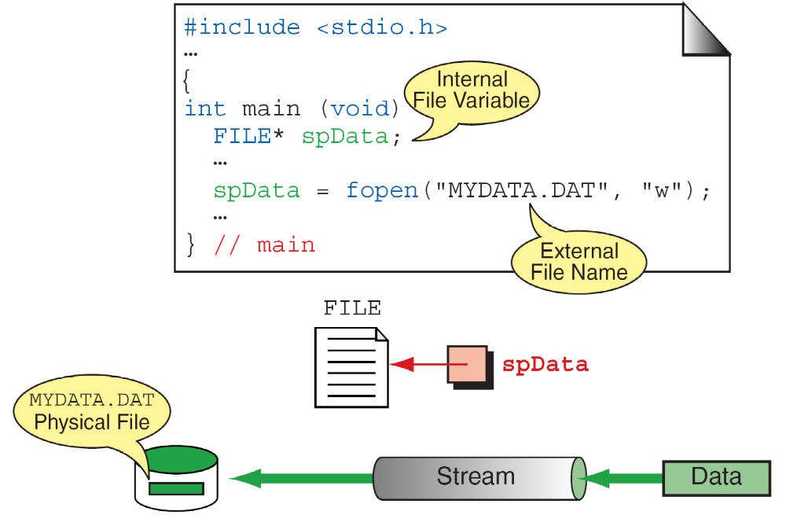
MORE ON FOPEN

Slide 14
FILE OPEN MODES
“r” opens for read only
“w” opens for writing, truncate to zero length
“a” open for writing, append to end of file
“r+” open an existing file for both reading & writing
“w+” open a new file for both reading and writing, truncate to zero length
“a+” open an existing file for reading and appending.
Maximum number of files opened at a time is limited and is system dependent, The actual limit is FOPEN_MAX, which is defined through stdio.h, and is always atleast 8 and typically 16 on linux

Slide 15
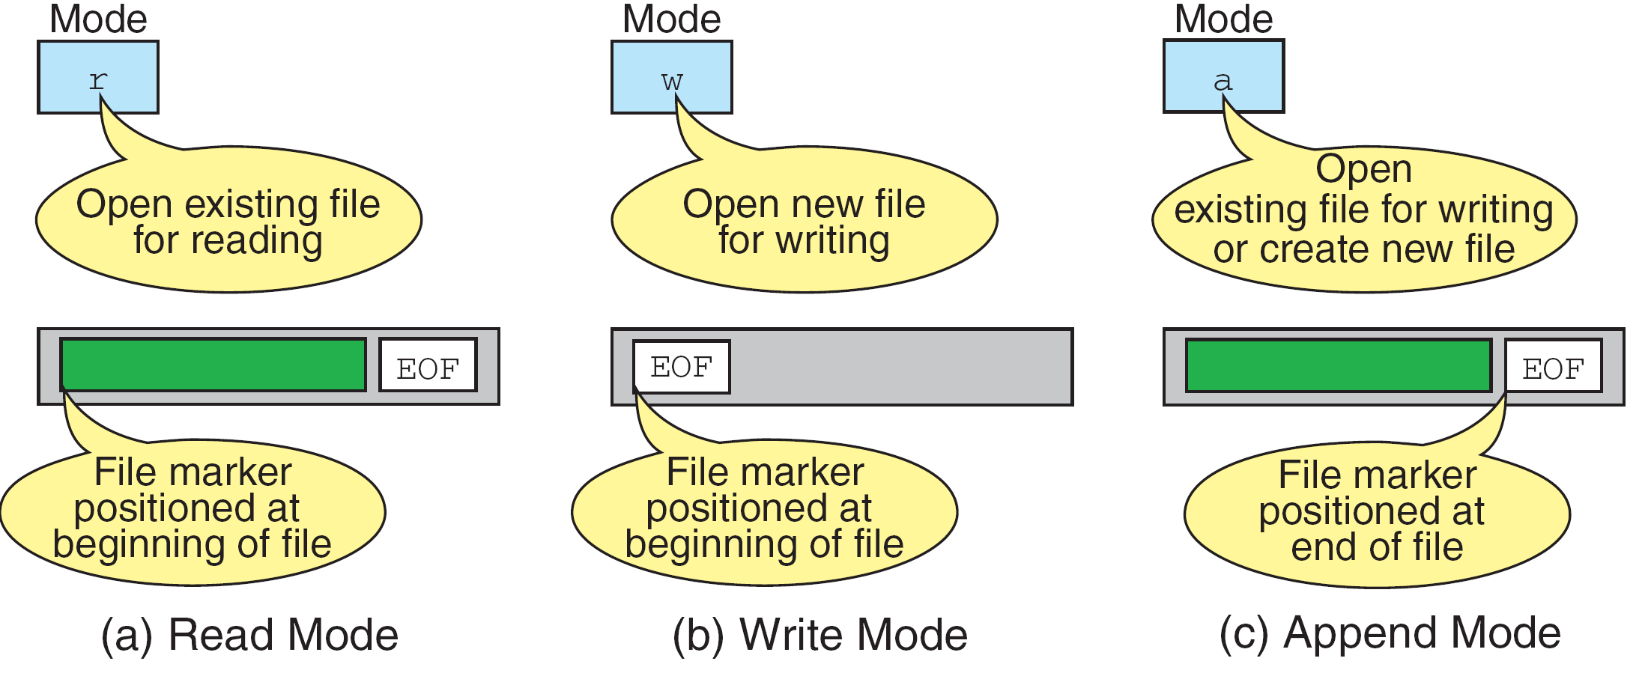
MORE ON FILE OPEN MODES

Slide 16
CLOSING A FILE
When we finish with a mode, we need to close the file before ending the program or beginning another mode with that same file.
To close a file, we use fclose and the pointer variable:
int fclose(spData);
Return value:
On Success, it returns 0
On error, it returns EOF.

Slide 17
FILE STRUCTURE
typedef struct
{
int level; // fill or empty level of buffer
unsigned flags; // file status flags
char fd; // file descriptor
int bsize; //buffer size
unsigned char _FAR *buffer; //data transfer buffer
unsigned char _FAR *curp; // current active pointer
short token; // used for validity checking
} FILE;

Slide 18
CHARACTER I/O FUNCTIONS
fgetc():
Declaration: int fgetc(FILE *stream);
Return value:
On success: it returns the character read.
On error: it returns EOF.
Ex: ch=fgetc(fp);
fputc():
Declaration: int fputc(char c,FILE *stream);
Return value:
On Success: it returns the value of character written;
On Error: it returns EOF
Ex: fputc (ch, fp);

Slide 19
STRING I/O FUNCTIONS
fputs():
Declaration: int fputs (const char *str, FILE *stream)
The function fputs writes the string pointed to by str to the stream pointed to by stream.
Return : On success: returns nonnegative
On failure: EOF.
Ex: fputs("something", f);
fgets():
Declaration: char *fgets(char *str, int num, FILE *stream);
Function: reads up to num-1 characters from stream and stores them in *str.
Return: returns str on success or a NULL pointer on failure
Ex: fgets (str, 126, fp);

Slide 20
INTEGER I/O FUNCTIONS
getw():
Declaration: int getw (FILE *stream)
The getw function obtains the next int (if present) from the stream pointed at by stream.
If successful, these routines return the next requested object from the stream. Character values are returned as an unsigned char converted to an int. If the stream is at end-of-file or a read error occurs, the routines return EOF.
Putw();
Declaration: int putw (int w, FILE *stream)
The putw function writes the specified int to the specified stream
The putw function returns 0 on success; EOF is returned if a write error occurs

Slide 21
FORMATTED I/O FUNCTIONS
fprintf();
Declaration: int fprintf(FILE *stream, const char *format, ...);
Function: outputs the values to the stream.
Return: returns the number of characters actually printed on success or a negative number on failure.
Ex: fprintf(fp, "this is a test %d %f", 10, 20.01);
fscanf();
Declaration: int fscanf(FILE *stream, const char *format, ...);
Function: It works exactly like the scanf() function except that it reads from the stream.
Return: returns the number of arguments actually assigned values or EOF on failure.
Ex: fscanf (fp, "%s%f", str, &f);

Slide 22
RECORD I/O FUNCTIONS
fread();
Declaration:
size_t fread(void *buf, size_t size, size_t count, FILE *stream); Function: reads count number of objects by size and stores them in *buf.
Return: returns the number of items actually read.
Ex: fread (bal, sizeof(float), 5, fp);
fwrite();
Declaration:
size_t fwrite(const void *buf, size_t size, size_t count, FILE *stream); Function: writes count number of objects.
Return: returns the number of items written on success. Fewer items written means failure.
Ex: fwrite(&f, sizeof(float), 1, fp);

Slide 23
FFLUSH & EOF LIBRARY FUNCTIONS
fflush();
Declaration: int fflush(FILE *stream); Function: force the buffer contents to be written to the file.
Return 0 on success or EOF on error.
feof();
Declaration: int feof(FILE *stream);
Function: determines whether the end of the file has been reached.
Return: A nonzero value: if the file pointer is at the end of the file. zero: otherwise.

Slide 24
FSEEK & FTELL FUNCTION
fseek():
Declaration: int fseek(FILE *stream, long int offset, int origin);
Function: moves the file position pointer.
Return: zero on success or nonzero on failure.
'origin' must be one of:
SEEK_SET Seek from start of file
SEEK_CUR Seek from current location
SEEK_END Seek from end of file
ftell():
Declaration: long int ftell (FILE *stream);
Function: returns the value for the file position pointer.
Return: returns -1 on failure.

